Slide 1
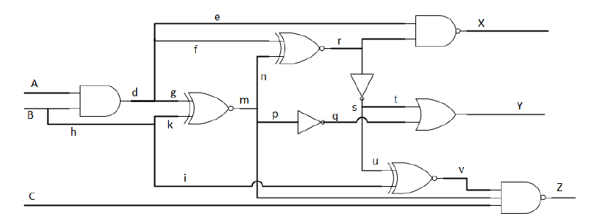

SS@1
PODEM
S – SS@1
EE658 – Diagnosis and Design of Reliable Digital Systems
Professor Tabar
M. Saeed Abrishami

Slide 2
SS@1
Note: Gate are shown using the letter representing their output.

Slide 3
PODEM()
All initial values are considered X, including the faulty node.

Slide 4
Objective()
Fault: INV_s SS@1, current value of INV_s = X
Objective: {INV_s, 0}

Slide 5
Backtrace(INV_S, 0)
D’
0
D’
D’

Slide 6
Backtrace(INV_S, 0)
1
1
D’
0
D’
D’

Slide 7
Backtrace(INV_S, 0)
0
1
1
D’
0
D’
D’

Slide 8
Backtrace(INV_S, 0)
0
1
0
1
0
D’
0
D’
D’

Slide 9
Backtrace(INV_S, 0)
0
1
0
1
0
0
D’
0
D’
D’

Slide 10
Backtrace(INV_S, 0)
0
1
0
1
0
0
D’
0
D’
D’
Note: PI can be considered as a gate in the algorithm.
A is PI, return (PI_A, 0)

Slide 11
Imply (PI_A, 0)
0
1
0
1
0
0
D’
0
D’
D’

Slide 12
Imply (PI_A, 0)
0
1
0
1
0
1
0
0
0
D’
0
D’
D’

Slide 13
PODEM
0
1
0
1
0
1
0
0
0
D’
0
D’
D’
Note: error is not at the output
Test is possible (no conflicts)

Slide 14
Objective
0
1
0
1
0
1
0
0
0
D’
0
D’
D’
Note: error is not at the output
Test is possible (no conflicts) D-frontier={OR_y, XNOR_v}
Objective = {OR_y, 0}

Slide 15
Backtrace(OR_y, 0)
0
1
0
1
0
1
0
0
0
D’
0
D’
0
D’

Slide 16
Backtrace(OR_y, 0)
0
1
0
1
0
1
0
0
0
D’
0
D’
0
1
0
0
1
0
D’

Slide 17
Imply(B, 0)
0
1
0
1
0
1
0
0
0
D’
0
D’
0
1
0
0
1
0
D’

Slide 18
Imply(B, 0)
0
1
0
1
1
0
1
1
0
0
0
D’
0
D’
D’
0
0
1
0
0
1
0
D’
0
1
D

Slide 19
PODEM
0
1
0
1
1
0
1
1
0
0
0
D’
0
D’
D’
0
0
1
0
0
1
0
D’
0
1
D
Note: error is at the output
SUCCESS

Slide 20
PODEM
0
1
0
1
1
0
1
1
0
0
0
D’
0
D’
D’
0
0
1
0
0
1
0
D’
0
1
D
Note: error is at the output
SUCCESS
T = {0, 0, X}

